Slide 1
COMP1003 – Algorithms, Data Structures & Maths
Session 02
Sets and Numbers
Thomas Wennekers
University of Plymouth

Slide 2
Overview
What Maths is about? Structure!
Naïve Set theory, some definitions and operations
Venn diagrams
Cartesian Product and Power Set
Number sets and arithmetic = ‘algebraic fields’
Positional number systems

Slide 3
What Maths (really) is about
Numbers and calculations?
Extremely important!
Yet only a tiny subset of Maths

Slide 4
What Maths (really) is about
Numbers and calculations?
Extremely important!
Yet only a tiny subset of Maths
Structure !
in the world (which makes Maths applicable)
and more general

Slide 5
What Maths (really) is about
Formal systems to describe structure and find laws about it – universal truth
Similar structures must obey these laws or theorems – addition applies to all countable things

Slide 6
What Maths (really) is about
Formal systems to describe structure and find laws about it – universal truth
Similar structures must obey these laws or theorems – addition applies to all countable things
Many of these structures are also used in Computing
“Informatics” = Mathematics of information

Slide 7
Examples of Structures
Arithmetic and numbers to calculate stuff
Logic and inference to come to conclusions
Arrays / Matrices / Vectors to store rectangular data
Graphs to express relationships
…. ….
Many structures are implemented in programming languages directly or as libraries

Slide 8
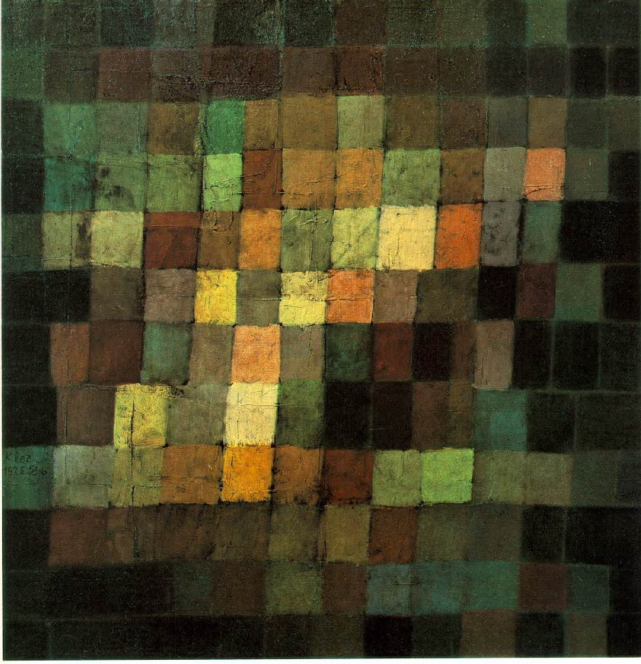
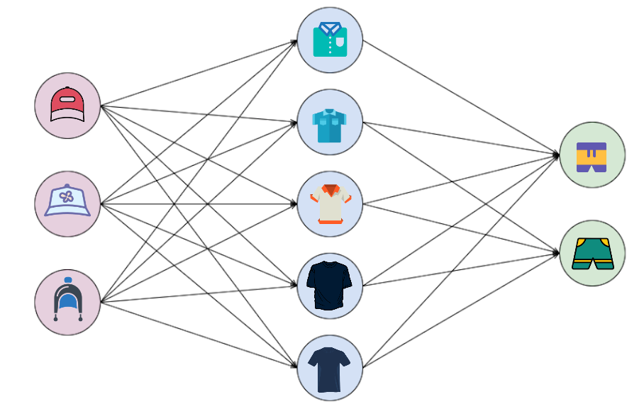
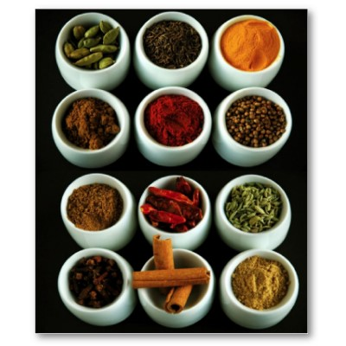
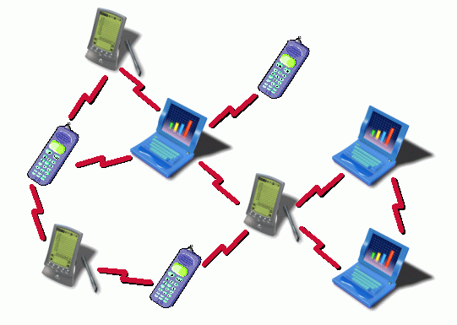
Left: arrays; right: graphs

Slide 9
Sets

Slide 10
Sets
Sets in Computing: to store collections/data, about which nothing else is assumed
Sets are the most generic structure
collections of unique things
Nearly all of Maths can be formally constructed using sets and further definitions
→ axiomatic set theory; branch of formal Logic

Slide 11
Naïve Set Theory
NSTs are defined informally (using natural language)
(plural!)
Suffices to describe familiar sets in discrete Maths
Words like if, then, and, or, for some, for all are interpreted in the intuitive sense
NST can lead to Paradoxes and contradictions

Slide 12
Naïve Set Theory Basics
Starts from
  Objects (can be anything unique)
  Sets are collections of objects; they are also objects
  Objects are the Elements of Sets
Element/membership operator
if x is not in A

Slide 13


Set Notations
List the elements: { 3, 5, 7} or { dog , cat }
  Order does not matter {2,3} equals {3,2}
  Duplicates don’t matter {1,1,2} equals {1,2}
“equals” means “all elements in set 1 are also in set 2 and the other way round
‘Empty’ set : or Note:

Slide 14
Set Builder Notations aka “comprehensions” (see Python)
all x for which some Predicate P(x) holds
Example: {x : x is in N } = { 1, 2, 3, 4 … }

Slide 15

Set Builder Notations aka “comprehensions”
all x for which some Predicate P(x) holds
Example: {x : x is in N } = { 1, 2, 3, 4 … }
all x in A for which P holds
{ x in N : x/2 equals 2 } = {4}

Slide 16

Set Builder Notations aka “comprehensions”
all x for which some Predicate P(x) holds
Example: {x : x is in N } = { 1, 2, 3, 4 … }
all x in A for which P holds
{ x in N : x/2 equals 2 } = {4}
Applying F to all x in A
{ x*x : x in {-1,1,3}} = {1,9}

Slide 17
Task
Define A := { x in N : x / 2 is odd }
A = { ??? }
{ y*y : y in A } = { ??? }
{ y*x : x in A and y=2 } = { ??? }

Slide 18

Sub- and Supersets
“Set inclusion”
Def: Given two sets A and B, A is a subset of B if all elements of A are also in B.
Notation: “A is subset or equal to B”
Note: Each set is a subset of itself
If A B and A is not equal to B, A is called a proper subset of B: A B
, are binary relations on sets (later more …)
If A is not a subset of B strike through the symbol

Slide 19


Set Operations
For two sets A and B
Union : all elements in both, A or B
Intersection : all elements in A and B
Set difference A\B : all in A but not B
Symmetric difference : all elements exactly once in A or B
Complement: If B is a subset of A, A\B is the complement of B in A, ie all elements in A that are not in B.

Slide 20

Definitions in Terms of
Comprehensions

Slide 21
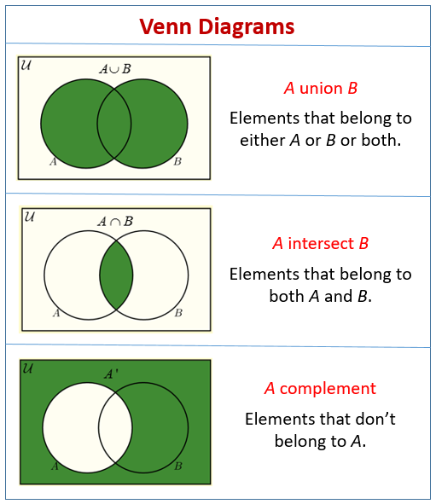
Venn Diagrams

Slide 22
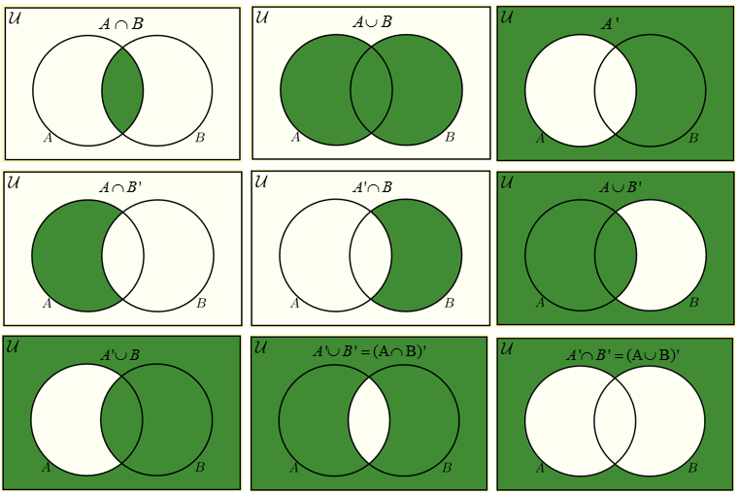
Venn Diagrams
(Maths by pictures)

Slide 23
Examples
A={1,2,3} B={2,3,4} U = {0,1,2,3,4,5}
= {1,2,3,4}
= {2,3}
A\B =
B\A =
=
A^{c} wrt U =

Slide 24
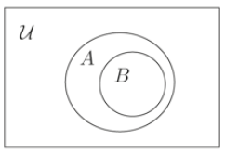
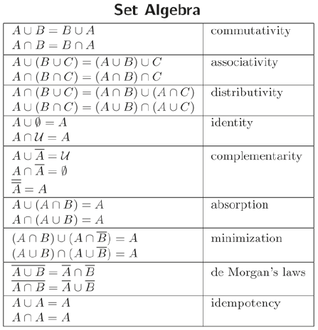
Set Algebra
Universal equivalences that hold for all sets whatever made of
N, Z, R, people, teapots, …
cf arithmetic on numbers

Slide 25
Cartesian Product
If A and B are sets the Cartesian Product is the set of all ordered pairs, A x B (eg R x R)
A = {1,2} B = {red, white}
AxB = { {1, red}, {1, white},
{2, red}, {2, white} }
= { {1, red}, {1, white}, {2, red}, {2, white} }

Slide 26
Power set
The set of all subsets of a set A is called its power set, P(A) or sometimes 2^{A}
Example: A ={1,2} → P(A) = { {}, {1}, {2}, {1,2} }

Slide 27
Question
A = { red, green, blue }
P(A) = { {}, {red}, {green}, ….}
But not P(A) = { {}, red, green, ….}
P(A) = ??

Slide 28
Answer
A = { red, green, blue }
P(A) = { {} , {red}, {green}, {blue},
{red, green}, {red, blue}, {green, blue},
{red, green, blue} }
8 elements

Slide 29
Power set
The set of all subsets of a set A is called its power set, P(A) or sometimes 2^{A}
Example: A ={1,2} → P(A) { {}, {1}, {2}, {1,2} }
If A has N elements, P(A) has 2^{N} Elements
Why ?

Slide 30
Proof by Induction
Proof that a statement S(N) holds for all N
Step1: Proof S(1)
Step 2: Proof that if S(N) holds, S(N+1) also holds
Step 3: by means of induction Step1 and Step 2 imply that S holds for all N in N = {1, 2, 3, 4 … }

Slide 31
Example
S(N) = N+1 is larger than N
1: S(1) : 2 is larger then 1 correct!
2: S(N) : N+1 is larger than N correct!
3: Conclusion: (1) and (2) imply the conjecture

Slide 32
S(N) =
for each set of size N its power set has size 2^{N}

Slide 33
Proof by Induction
The statement is true for empty sets, N=0
The power set is { {} } which has 1 element

Slide 34
Proof by Induction
1) The statement is true for empty sets, N=0
2) If the statement is true for any set A with N elements, a set B with one more Element x allows for the same subsets P(A) plus all those P(A) with the new element added.
Therefore P(B) = 2 * P(A) = 2*2^{N} = 2^{N+1}

Slide 35
Proof by Induction
1) The statement is true for empty sets, N=0
2) If the statement is true for any set A with N elements, a set B with one more Element x allows for the same subsets P(A) plus all those P(A) with the new element added.
Therefore P(B) = 2 * P(A) = 2*2^{N} = 2^{N+1}
3) By induction over N the statement is proven

Slide 36
Another Proof
The elements of A can be represented by N bits (in some order)

Slide 37
Another Proof
The elements of A can be represented by N bits (in some order)
If an element is in a subset its bit is 1 otherwise 0
This characterises all subsets uniquely.

Slide 38
Another Proof
The elements of A can be represented by N bits (in some order)
If an element is in a subset its bit is 1 otherwise 0
This characterises all subsets uniquely.
There are 2^{N} different numbers represented by N bits

Slide 39
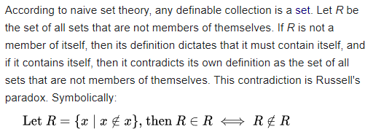
Russel’s Paradox
Naïve Set Theory can lead to contradictions

Slide 40
Russel’s Paradox
Naïve Set Theory can lead to contradictions
Unrestricted comprehension is false

Slide 41
Construction of the Natural Numbers from Sets (Idea)
{} != {{}}
One can successively put sets into sets
Give these unique sets names
0 := {}
1 := {{}} = {0}
2 := {{{}}} = {1}
…
N := {0,1,2,3 …} = “The natural numbers”

Slide 42
Numbers

Slide 43
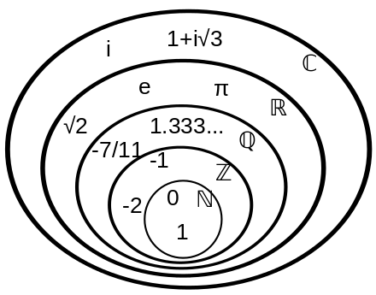
Some important Sets
Number Systems
N: Natural Numbers ( 0,1,2..)
Z: Integer Numbers (..-3,-2,-1,0,1,2..)
Q: Rational Numbers (x=q/p, p,q in Z)
R: Real numbers (the whole line)
C: Complex numbers ( i=sqrt(-1) )
Historically various number systems were discovered when limitations of previously used systems became obvious.

Slide 44
Subtraction leads out of N → Integers Z required
Division leads out of Z → Rationals Q
Transcendental numbers (pi, e) → Reals R
Square root leads out of R → Complex numbers C

Slide 45
Number Sets as
(Algebraic) Structures
You know (most?) of the number sets explained
You have practical experience with N, Z and R

Slide 46
Number Sets as
(Algebraic) Structures
You know (most?) of the number sets explained
You have practical experience with N, Z and R
Q, R and C are different sets with commonalities:
+,-,*,/, commutative, associative, and distributive laws

Slide 47
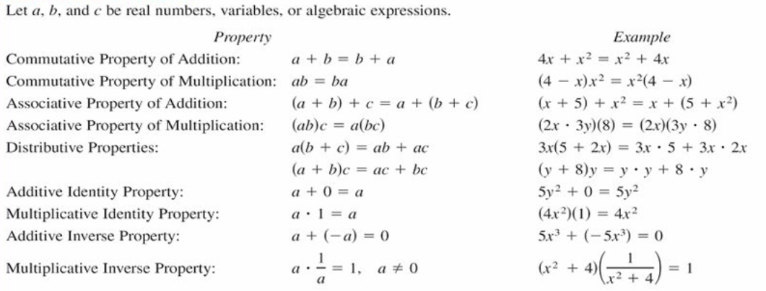
Basic Rules of Algebra

Slide 48
Number Sets as
(Algebraic) Structures
You know (most?) of the number sets explained
You have practical experience with N, Z and R
Q, R and C are different sets with commonalities:
+,-,*,/, commutative, associative, and distributive laws
Q, R and C are mathematical structures called fields.

Slide 49
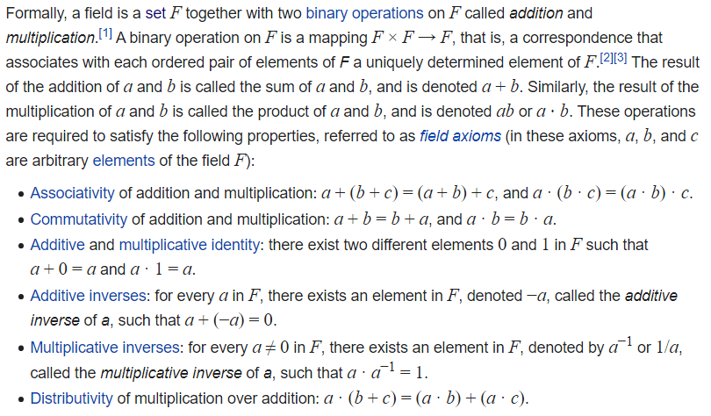
Algebraic Structure: Field

Slide 50
Number Sets as
(Algebraic) Structures
You know (most?) of the number sets explained
You have practical experience with N, Z and R
Q, R and C are different sets with commonalities:
+,-,*,/, commutative, associative, and distributive laws
Q, R and C are mathematical structures called fields.
N and Z are not fields: + and * do not always have inverses 2-3 is not in N, 2/3 is not in Z

Slide 51
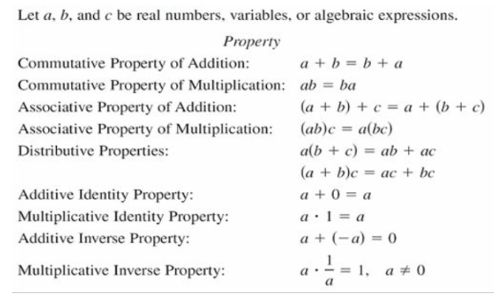
Algebras
Variables, (Numbers Q,R) & Sets
Technically similar structures, but note that numbers are ordered, whereas set elements need not be.

Slide 52
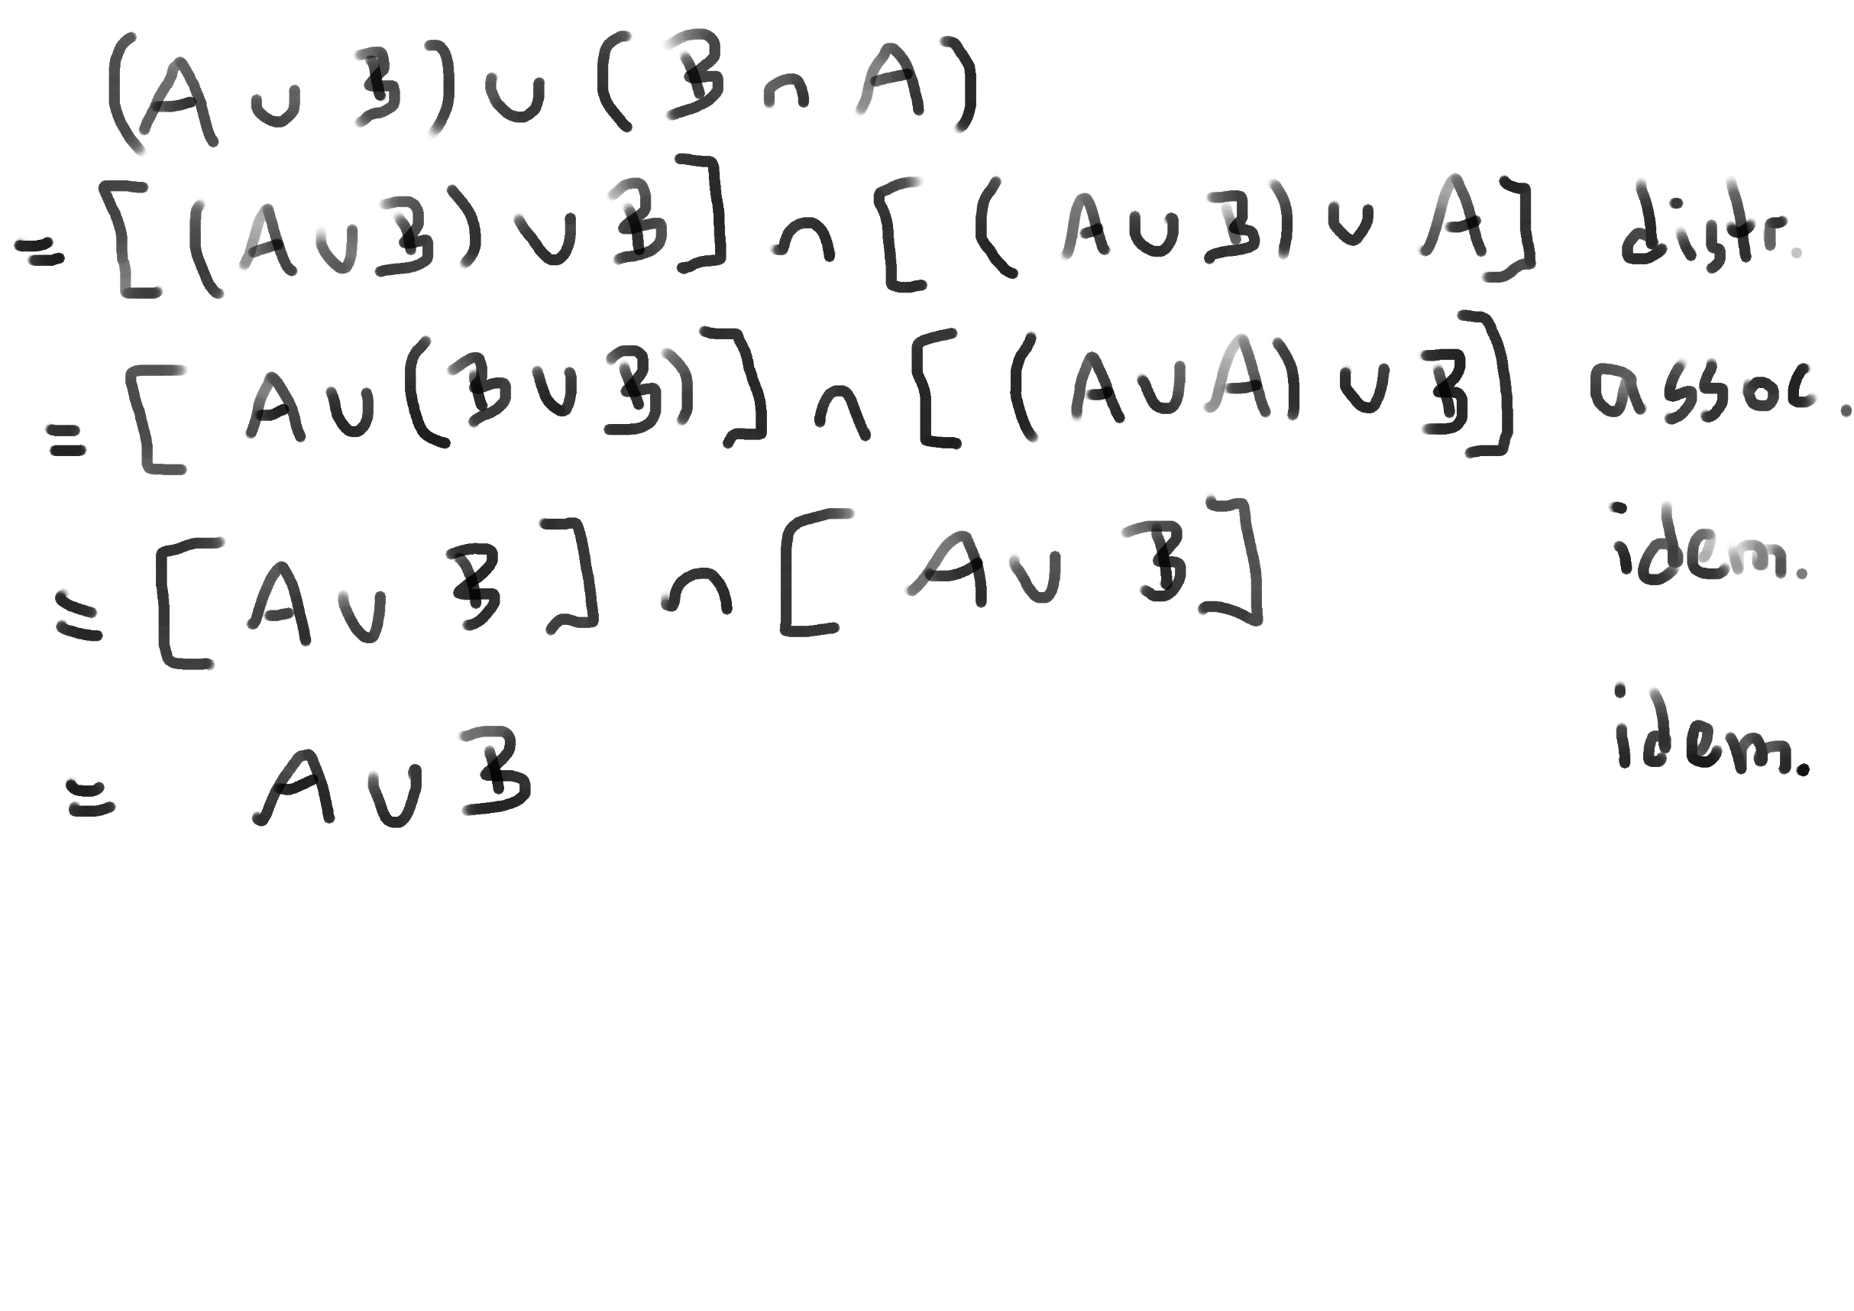
Algebra with Sets

Slide 53
Algebraic Rules on Numbers
https://themathpage.com/aPreCalc/algebraPre.htm
This page contains much of what is assumed students know about calculations with numbers and variables
See also session 01 and worksheet 1

Slide 54
Numbers and Arithmetic on Computers
The number fields define the basic arithmetic, which everybody should know from school
On Computers only approximate N,Z,Q,R,C can be implemented due to memory limitations

Slide 55
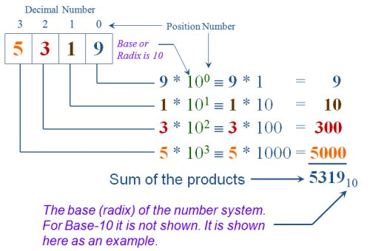
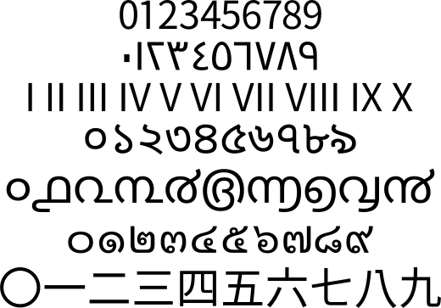
Positional Number Representations
Individual names for many numbers are impractical
Instead a small set of symbols is used
Together with a positional number system

Slide 56
Question
What is the decimal representation of 1011₂ ?
What is the binary representation of 13₁₀ ?
What is the octal representation of 13₁₀ ?
(Vasilis covered this in the first Semester)

Slide 57
Question
What is the decimal representation of 1011₂ ?
1 + 2*1 + 4*0 + 8*1 = 8+2+1 = 11
What is the binary representation of 13₁₀ ?
13/2=6 R 1; 6/2=3 R 0; 3/2 = 1 R1; 1/2= 0 R1 -> 1101
What is the octal representation of 13₁₀ ?
1 | 101 -> 15

Slide 58
Summary
Sets are a universal data structure and algebra
Sets lie at the base of Mathematics
Numbers are sets (and can be defined using sets)
Addition and multiplication make Q, R & C fields
Set data structures are available in computer languages either natively or as libraries
Finite number representations allow for approximate arithmetic

